Slide 1
CPS 235 Object Oriented Programming Paradigm
Lecturer Rabia Khan
Operator Overloading

Slide 2
Operator Overloading
As studied before, there are four default functions that the compiler creates for you if you do not define them yourself, the default constructor, the copy constructor, and the destructor, the compiler also create an overloaded assignment operator function for you.
To use the assignment operator on your own object in your own way, you should (or must) let the compiler know how to handle the assignment operator on a variable declared from such an object. To do this, create your own implementation of the assignment operator.
Operator overloading is a powerful feature of C++
It provides programmers with a concise notation for manipulating user defined objects. It is simple to implement given a few basic rules
CPS235:Operator Overloading

Slide 3
Why Operator Overloading ?
int i, j, k; // integers
float m, n, p; // floats
// integer addition and assignment
k = i + j;
// floating addition and assignment
p = m + n;
The compiler overloads the + operator for built-in integer and float types by default, producing integer addition with i+j, and floating addition with m+n
We can make object operation look like individual variable operation, using operator functions
Complex a,b,c;
c = a + b;
CPS235:Operator Overloading

Slide 4
Operators in C++
C++ has a rich collection of operators most of which are common to other programming languages
Standard arithmetic and logical operators
  + - * / % & ! > < || && == etc
Array indexing and function evaluation operators
  [] ()
Assignment operators
  = += -= *= /= etc.
Auto increment and decrement operators
  ++ --
Pointer de-referencing and address of operators
  * &
Memory management operators
  new delete new[] delete[]
CPS235:Operator Overloading

Slide 5
Operators in C++
We can divide up the set of operators into unary and binary operators
A unary operator has one operand
Examples
if (!x) {..} // unary operator !, operand x
x++; // post-fix operator ++, operand x
--x; // pre-fix operator --, operand x
int y=a[5]; // operator [], operand a
CPS235:Operator Overloading

Slide 6
Operators in C++
A binary operator has two operands
Examples
int z=x+y; // binary operator +, operands x and y
bool z=x&&y;// binary operator && operands x and y
x+=y; // binary operator +=, operands x and y
CPS235:Operator Overloading

Slide 7
Operator Overload Functions
In order to overload an operator op, a function operator op must be defined
  operator+ to overload +
  operator+= to overload +=
  etc
We can either provide member functions of a class or external functions (possibly friend functions of a class)
CPS235:Operator Overloading

Slide 8
Restrictions on operator overloading
Overloading an operator cannot change it’s precedence
Overloading an operator cannot change the number of operands
It is not possible to create new operators, only new versions of existing operators can be created
Operator meaning on built-in features cannot be changed
  For instance you cannot change the “+” for integers
At least one argument of an operator function must be an object or reference of a user-defined type
  This prevents programmers from changing how operators work on fundamental types
CPS235:Operator Overloading

Slide 9
Operator Overloading Syntax
Syntax is:
Examples:
operator+
operator-
operator*
operator/
operator@(argument-list)
operator is a function
@ is one of C++ operator symbols (+, -, =, etc..)
CPS235:Operator Overloading

Slide 10
Operator Overloading Format
Format
  The name of an operator is always a conjunction of the keyword operator and then the symbol itself
  Examples
    Operator+
    Operator++
    Operator- -
    Operator –
    Operator <<
    Operator ==
    Operator =
CPS235:Operator Overloading

Slide 11
Operators that can be overloaded
+ | - | * | / | % | ^
& | | | ~ | ! | = | <
> | += | -= | *= | /= | %=
^= | &= | |= | << | >> | >>=
<<= | == | != | <= | >= | &&
|| | ++ | -- | ->* | , | ->
[] | () | new | delete | new[] | delete[]
CPS235:Operator Overloading

Slide 12
Operators that cannot be overloaded
. | .* | :: | ?:
CPS235:Operator Overloading

Slide 13
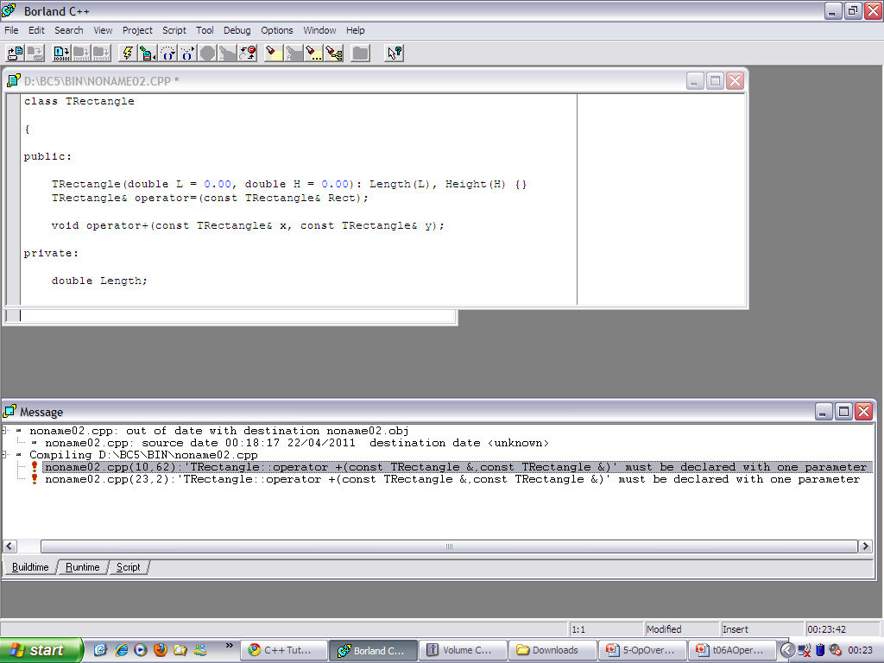
Example
class Trectangle
{
public:
TRectangle(double L = 0.00, double H = 0.00): Length(L), Height(H) {}
void operator+(const TRectangle& x, const TRectangle& y);
private:
double Length;
double Height;
};
void TRectangle::operator+(const TRectangle& x, const TRectangle& y)
{ x.Length + y.Length;
x.Height + y.Height;
}
C++ does not allow a binary operator to be overloaded (with two or more arguments) in a class. The solution is to declare the function outside of the class. The problem is that, to perform this binary operation, you will need access to the private or protected members of the class. Therefore, the operator function must be declared as a friend of the class
CPS235:Operator Overloading

Slide 14
Example
class TRectangle
{
friend TRectangle operator+(const TRectangle& x, const TRectangle& y);
public:
TRectangle(double L = 0.00, double H = 0.00):Length(L), Height(H) {}
private:
double Length;
double Height;
};
TRectangle operator+(const TRectangle& x, const TRectangle& y)
{TRectangle temp;
temp.Length = x.Length + y.Length;
temp.Height = x.Height + y.Height;
return temp;}
int main ()
{ TRectangle Rect1(42.88, 36.14), Rect2(16.52, 22.65), Result;
Result = Rect1 + Rect2;
getch();
}
CPS235:Operator Overloading

Slide 15
Example
class TRectangle
{
friend TRectangle operator+(const TRectangle& x, const TRectangle& y);
public:
TRectangle(double L = 0.00, double H = 0.00):Length(L), Height(H) {}
void display()
{
cout<< " \n" <<Length;
cout<<" \n " <<Height;
}
private:
int Length;
int Height;
};
TRectangle operator+(const TRectangle& x, const TRectangle& y)
{ TRectangle temp;
temp.Length = x.Length + y.Length;
temp.Height= x.Height + y.Height;
return temp;
}
int main ()
{ TRectangle Rect1(42, 36), Rect2(16, 22), Rect3 (2,2), Result;
Result = Rect1 + Rect2 + Rect3;
Rect1.display();
Rect2.display();
Result.display();
}
An object returned which can be added further to any number of operands

Slide 16
Similarly, to declare the other arithmetic operators, use the same syntax.
class TRectangle
{
friend TRectangle operator+(const TRectangle& x, const TRectangle& y);
friend TRectangle operator-(const TRectangle& x, const TRectangle& y);
friend TRectangle operator*(const TRectangle& x, const TRectangle& y);
friend TRectangle operator/(const TRectangle& x, const TRectangle& y);
public : .....
private : ......
};
CPS235:Operator Overloading

Slide 17
Operator Overloading Binary Operators
However, not necessarily does a binary operator have to be a friend function. If the operator overloading function is written with 1 argument then C++ allows it to be a member function of the class.
CPS235:Operator Overloading

Slide 18
Overloading Binary Operators (using member functions)
class counter
{
private:
int count;
public:
counter():count(0){}
counter(int c):count(c) {}
int get_count()
{
return count;
}
counter operator+(const counter & rhs)
{
return (counter(count+rhs.count));
}
};
CPS235:Operator Overloading

Slide 19
Overloading Binary Operators (using member functions)
int main()
{
counter c1(10), c2(10), c3;
c3 = c1 + c2; //or c3 = c1.operator+(c2);
cout<<'\n'<<c3.get_count();
getch();
return 0;
}
CPS235:Operator Overloading

Slide 20
Implementing Binary Operator Overloading
Expression obj1@obj2 translates into a function call
Two ways:
  Implemented as member functions
    obj1.operator@(obj2), if this function is defined within the class of which obj1 is a member
  Implemented as non-member or Friend functions
    the operator function may need to be declared as a friend if it requires access to protected or private data
    operator@(obj1,obj2), if this function is defined outside the class of which obj1 is a member (friend function)
    operator@(access_function1() ,access_function2()), if this function is defined outside the class of which obj1 is a member (but not as friend function)
CPS235:Operator Overloading

Slide 21
Implementing Binary Operator Overloading
Defined as a member function
class Complex {
...
private: double _real, double _imag;
public:
...
Complex operator +(const Complex &op)
{
double real = _real + op._real;
double imag = _imag + op._imag;
return(Complex(real, imag));
}
...
};
c = a+b;
c = a.operator+(b);
CPS235:Operator Overloading

Slide 22
Implementing Binary Operator Overloading
Defined as a non-member function
Complex operator +(Complex &op1, Complex &op2)
{
double real = op1.real() + op2.real();
double imag = op1.imag() + op2.imag();
return(Complex(real, imag));
}
c = a+b;
c = operator+ (a, b);
CPS235:Operator Overloading

Slide 23
Implementing Binary Operator Overloading
Defined as a non-member function
If you still do not want to give access to private members of the class then public ‘get’ functions are required which can return these values..
class Complex {
...
public:
...
//need access functions
double real() { return _real; }
double imag() { return _imag; }
...
};
CPS235:Operator Overloading

Slide 24
Implementing Operator Overloading
Defined as a friend function
class Complex {
...
public:
...
friend Complex operator +(
const Complex &,
const Complex &
);
...
};
c = a+b;
c = operator+ (a, b);
Complex operator +(Complex &op1, Complex &op2)
{
double real = op1._real + op2._real;
double imag = op1._imag + op2._imag;
return(Complex(real, imag));
}
CPS235:Operator Overloading

Slide 25
Summary - Forms of Overloaded Operators
Member Functions
Friend Functions
Free-Standing or Global Functions
CPS235:Operator Overloading

Slide 26
Operator Functions
When to make operator functions class members, friends or global functions?
If operator overload function is a member function, then “this” is implicitly available for one of the arguments
When overloading =, ( ), [ ], ->, the operator overloading function must be declared as a class member. For other operators, the overloading functions can be non-members
CPS235:Operator Overloading

Slide 27
Operator Functions
When an operator function is implemented as a member function, the left most (or only in the case of unary operators) operand must be a class object (or a reference to a class object) of operator's class
If the left operand must be an object of a different class or a built-in type, this operator must be implemented as a non-class member. eg. <<, >> operators
CPS235:Operator Overloading

Slide 28
Operator Functions
An operator function implemented as a non-member must be a friend if it needs to access non-public data members of that class
The overloaded << operator must have a left operand of type ostream. Therefore, it must be a non-member function. Also, it may require access to the private data members of the class. Thus, it needs to be a friend function for that class
Similar observation holds for >> operator which has a left operand of type istream
CPS235:Operator Overloading

Slide 29
Operator Functions
Operator member functions are classed only when the left operand of a binary operator is specifically an object of that class or when the single operand of a unary operator is an object of that class
If the operator needs to be commutative (a + b = b + a), then making it a non-member function is necessary
CPS235:Operator Overloading

Slide 30
Overloading Unary Operators (using member functions)
class counter
{
private:
int count;
public:
counter():count(0){}
counter(int c):count(c) {}
int get_count()
{ return count; }
counter operator++ () //prefix operator
{
++count;
counter temp;
temp.count = count;
return counter(count);
}
counter operator++(int) //postfix operator
{ return counter(count++); }
};
CPS235:Operator Overloading

Slide 31
Overloading Unary Operators (using member functions)
int main()
{
counter c1, c2, c3;
++c1; // or c1.operator++();
++c2;
cout<<'\n'<<c1.get_count();
cout<<'\n'<<c2.get_count();
cout<<endl;
c3 = c1++; //or c3 = c1.operator++(0);
cout<<'\n'<<c3.get_count();
cout<<'\n'<<c1.get_count();
getch();
return 0;
}
CPS235:Operator Overloading

Slide 32
Overloading the Comparison Operators
class Distance
{
int feet;
float inches;
public:
Distance():feet(0),inches(0.0){}
Distance(int ft, float in):feet(ft),inches(in){}
void display() const
{ cout<<feet<<"\'-"<<inches<<'\"'; }
bool operator<(Distance&) const;
};
bool Distance::operator<(Distance& d1) const
{
float f1 = feet + inches/12;
float f2 = d1.feet + d1.inches/12;
return (f1<f2)? true : false;
}
CPS235:Operator Overloading

Slide 33
Overloading the Comparison Operators
void main()
{
Distance d1(5, 11.5);
Distance d2(6, 2.5);
if(d1<d2)
{
cout<<"the distance";d1.display();
cout<<"is less than";d2.display();
cout<<endl;
}
else
{
cout<<"the distance";
d1.display();
cout<<"is greater than/equal to"; d2.display();
cout<<endl;
}
getch();
}
CPS235:Operator Overloading

Slide 34
What if you want to add two objects, both of different types??

Slide 35
class CSquare;
class CRectangle {
public: int width, height;
CRectangle()
{
width=2;
height=2;
}
int area () {return (width * height);}
void operator+ (CSquare a);
};
class CSquare {
private: int side;
public:
void set_side (int a) {side=a;}
friend void CRectangle::operator+(CSquare);
};
void CRectangle::operator+ (CSquare a) {
width= width + a.side;
height = height + a.side;
}
int main () {
CSquare sqr;
CRectangle rect; //rectangle width and height 2,2 set
sqr.set_side(4);
rect+sqr; // now sides of rectangle are 6,6
cout << rect.area();
}

Slide 36
Why would we need to make overloaded operators non-member functions?
CPS235:Operator Overloading

Slide 37
class Time
{
private:
int hours;
int mins;
public:
Time():hours(0),mins(0){}
Time(int h, int m):hours(h),mins(m){}
void display()
{
cout<<hours<<"-"<<mins<<endl;
}
Time operator*(double mult_mins) const
{
Time result;
long totalminutes = (hours * 60) + (mins * mult_mins);
result.hours = totalminutes / 60;
result.mins = totalminutes % 60;
return result;
}
};
CPS235:Operator Overloading

Slide 38
void main()
{
Time t1;
Time t2(5,40);
cout<<"t2 is:";
t2.display();
t1 = t2 * 2;
//t1 = 2 * t2; //ILLEGAL STRUCTURE OPERATION
cout<<"t1 is:"; t1.display();
getch();
}
CPS235:Operator Overloading

Slide 39
Implementing overloaded operators as non-member functions
When an overloaded operator is defined as a member function, the left operand is always an object on which the function is called
So, in the previous example we have
t1 = t2 * 2; // t1.operator*(2)
When we write t1 = 2 * t2; the left operand is no longer an object on which the function can be invoked
Solution: Implement the overloaded operator function as a non-member function
  Since this function needs to access the private data members of the Time class, we declare it as a friend in the Time class declaration
CPS235:Operator Overloading

Slide 40
Implementing overloaded operators as non-member functions
//goes into the declaration of class Time
friend Time operator* (double,const Time&);
//function defined outside class declaration
Time operator*(double mult_mins,const Time& t)
{
Time result;
long totalminutes = (t.hours * 60) + (t.mins * mult_mins);
result.hours = totalminutes / 60;
result.mins = totalminutes % 60;
return result;
}
CPS235:Operator Overloading

Slide 41
Overloading the Assignment Operator
See code example assignment.cpp
To enable chaining i.e., om3 = om2 = om1;
void operator=(const omega& rhs)
{
strncpy(name,rhs.name,size);
}
omega operator=(const omega& rhs)
{
strncpy(name,rhs.name,size);
return omega(name);
}
CPS235:Operator Overloading

Slide 42
Compulsory Reading
Robert Lafore, Chapter 8: Operator Overloading
Deitel and Deitel (5th edition)
  Topics 11.1 – 11.4, 11.6, 11.7
Another useful link:
  http://newdata.box.sk/bx/c/htm/ch10.htm#Heading23
CPS235:Operator Overloading

